Slide 1
Implementations and Uses of Singular Value Decomposition
Dylan Laurianti and Yilan Dong
CSC 395: Network Science
Professor Eikmeier

Slide 2



What is Singular Value Decomposition?
Singular Value Decomposition is a matrix factorization
Applies very generally to rectangular, dense and complex matrices
Unitary Matrix – A matrix whose conjugate transpose is its inverse
If chosen so that singular values are in descending order, the SVD is unique

Slide 3
Why and how do people use SVDs?
Can be used to calculate
Range, null space and rank
Nearest orthogonal matrix
Pseudoinverse
Widely used in data preprocessing
To reduce the size and dimension of the data
To minimize the effects of noisy data
In fields such as
Network Science, Natural Language Processing, Information Retrieval, Computer Vision and Bioinformatics

Slide 4
Goals
Understand, implement and explore the use cases of SVD.
Implement the original SVD, one reduced SVD, as well as at least one other variation.
Measure the correctness of our algorithms with comprehensive tests suites.
Measure the robustness and efficiency of our implementation by comparing them with the existing SVD methods in Julia.

Slide 5
Initial Results
We have completed the implementation for most parts of the original SVD algorithm and expect the other algorithms to present less of a challenge once this has been finished.
The testing suite has been completed, and just needs algorithms to test.

Slide 6
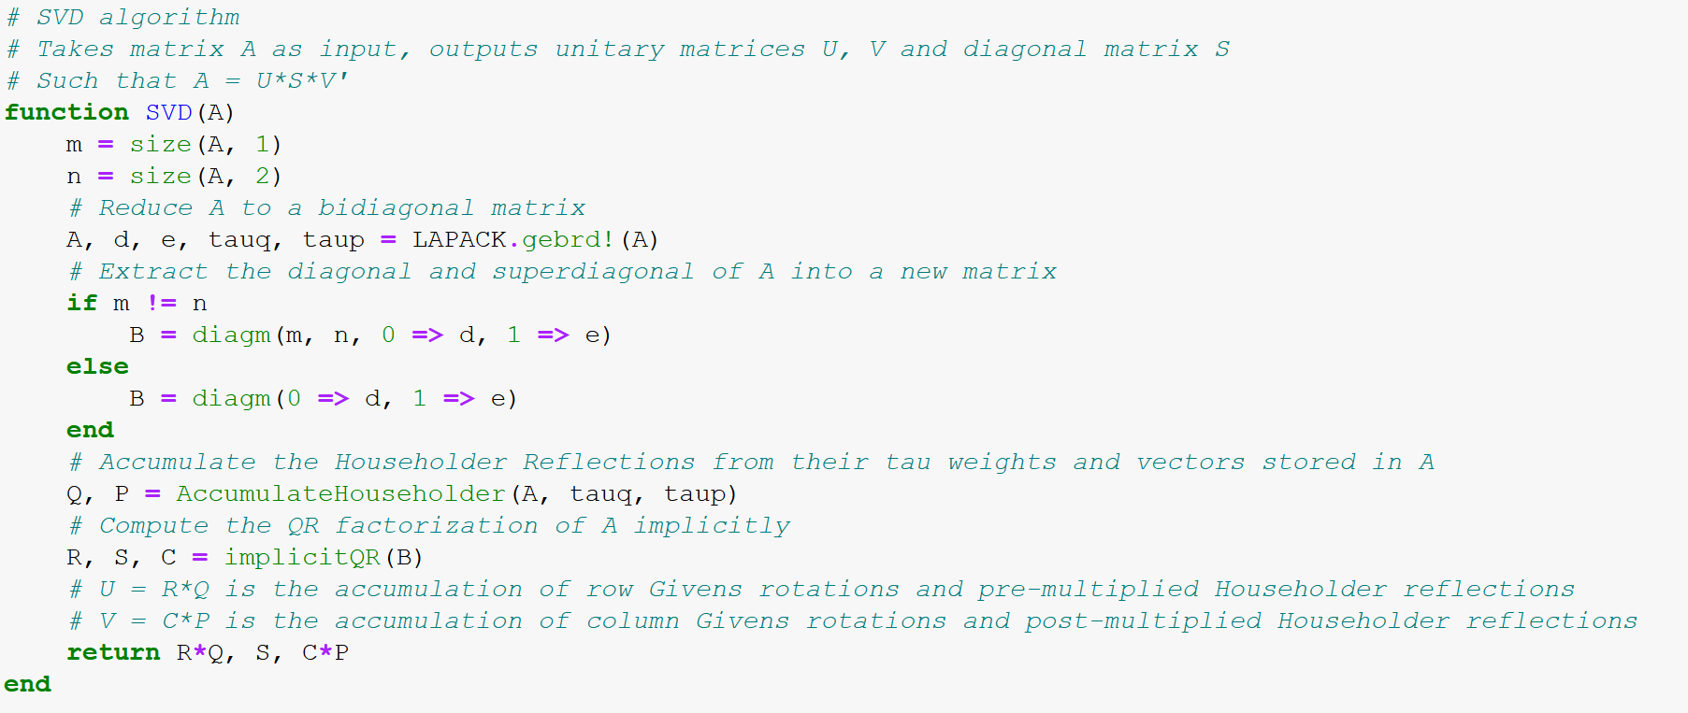
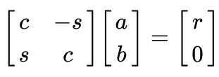

Current Implementations
Terms
Givens Rotation – A rotation that takes a 2-vector and turns it counterclockwise onto the axis.
Householder Reflection – A reflection about the hyperplane orthogonal to a vector.
Wilkinson Shift – Shifting by an eigenvalue of a 2x2 submatrix so that the superdiagonal entries converge to zero much faster.
Decoupling – Separation of variables such that they no longer interact for the remaining iterations, so that they can then be solved for independently.

Slide 7
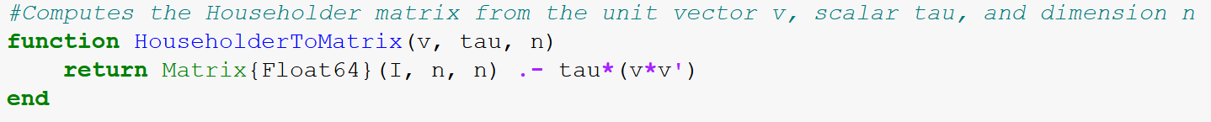
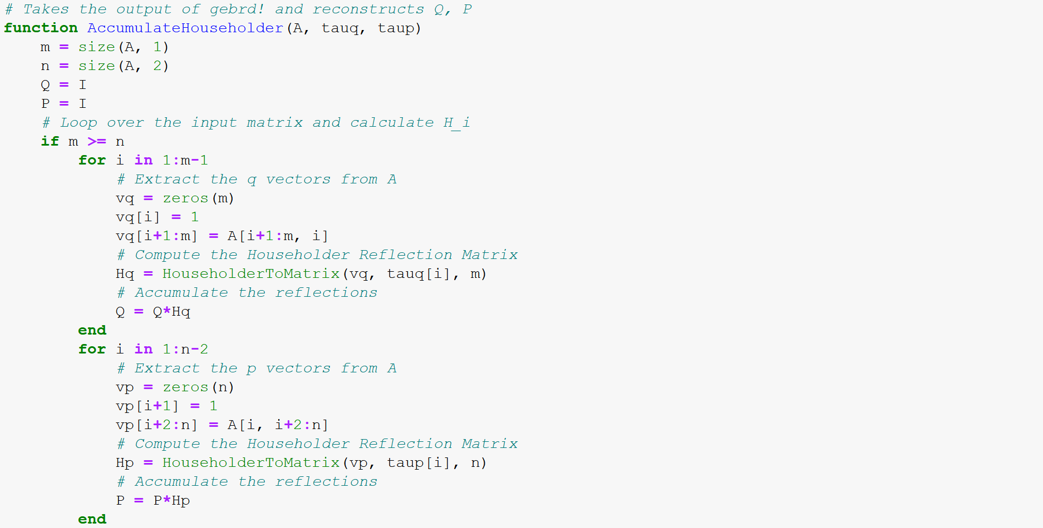
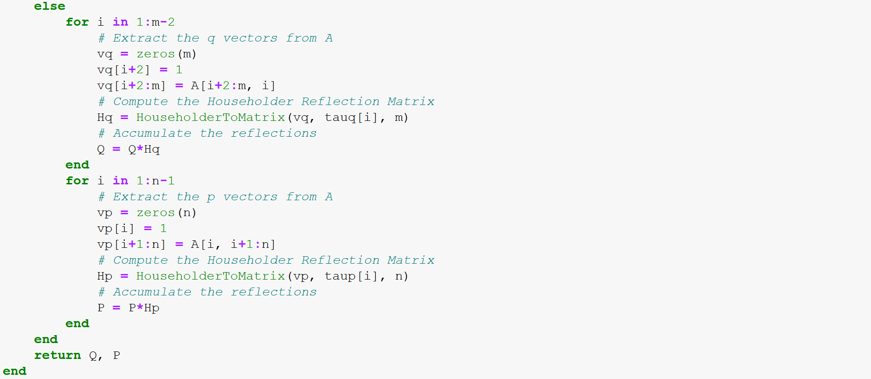
Current Implementations

Slide 8
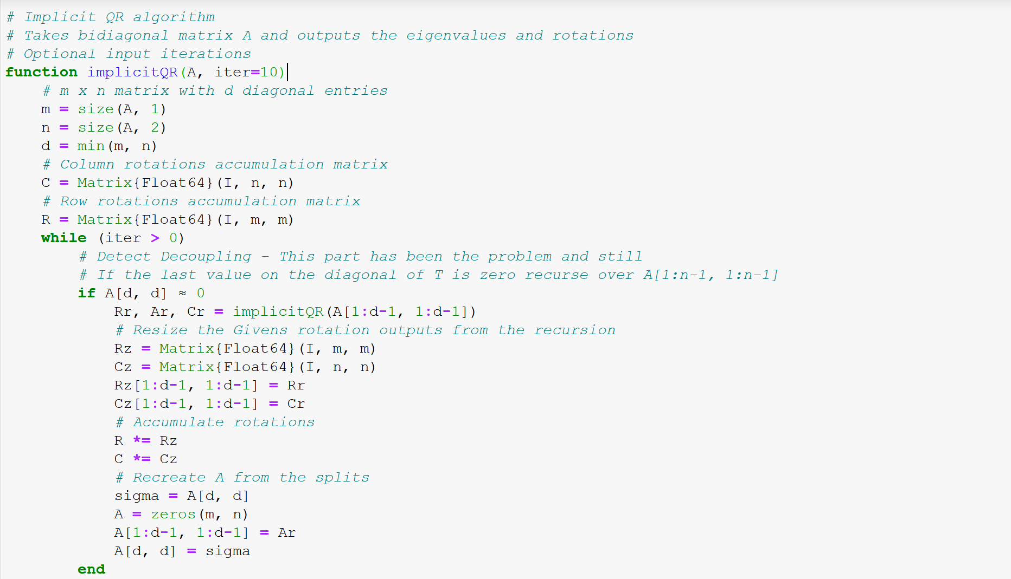
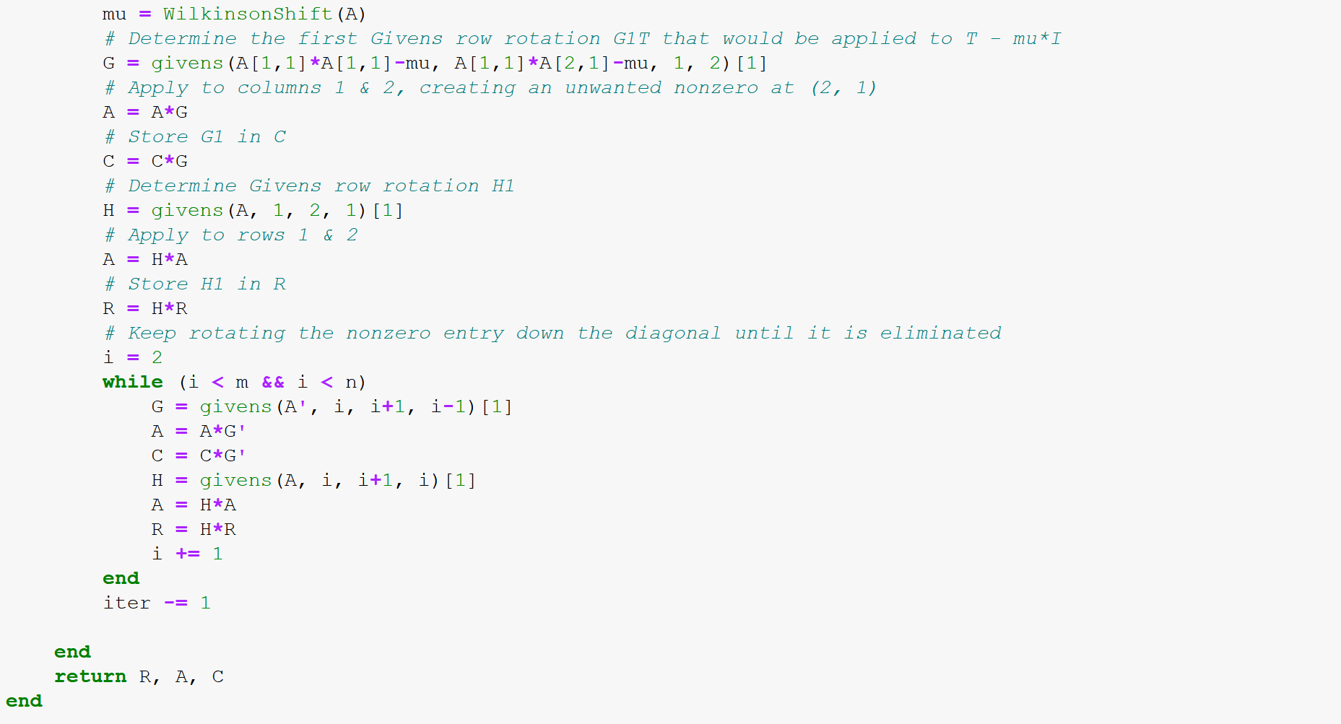
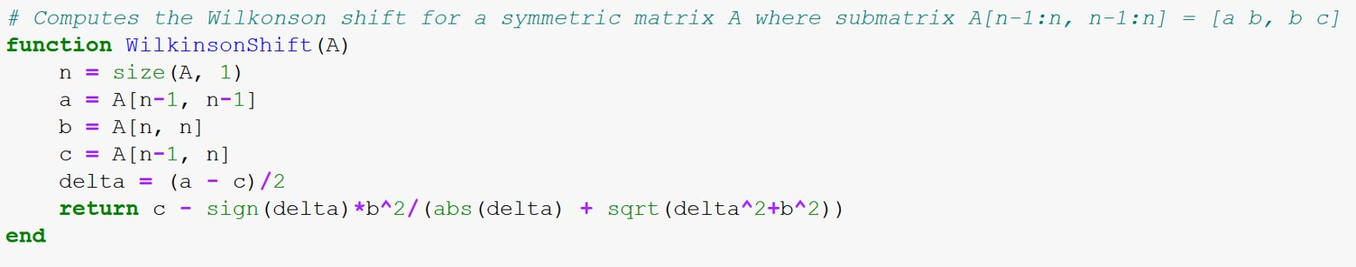
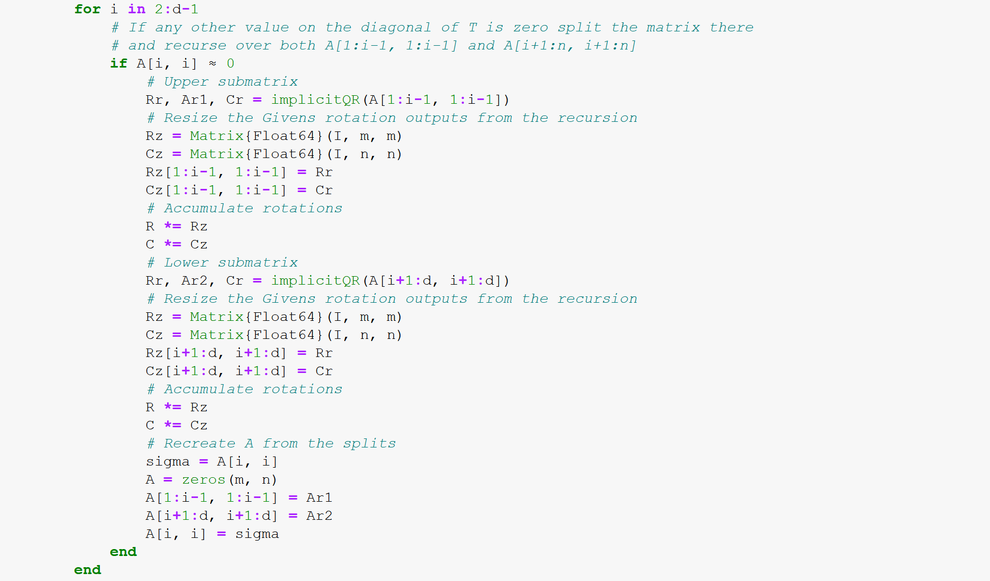
Current Implementations

Slide 9
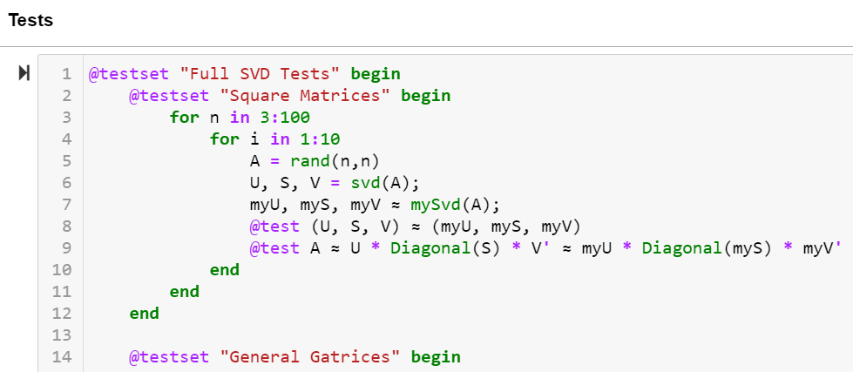
Performance Measurements

Slide 10
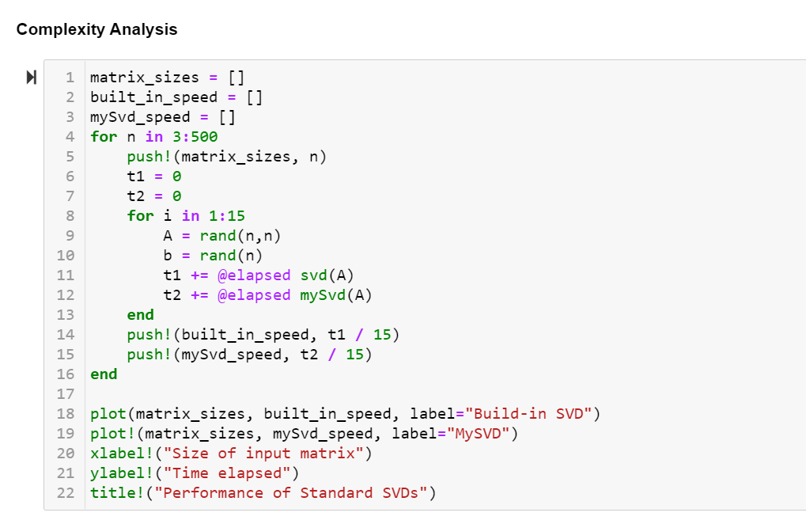
Performance Measurements

Slide 11
Difficulties
The part of the SVD algorithm that is causing difficulties is the implicit QR Factorization.
The rotations in the algorithm seem to be correctly applying the bulge chasing method but it is failing to produce zeros in the superdiagonal entries.
It seems likely that the problem is in the decoupling stage of the algorithm.

Slide 12
Future Work
Implement two reduced SVDs
Thin SVD
Truncated SVD
Performance Measurement
Correctness
Efficiency

Slide 13
Works Cited
https://en.wikipedia.org/wiki/Singular_value_decomposition
Stewart, G. W. On the early history of the singular value decomposition. SIAM Review35, 4 (1993), 551–566
Willems, P. R., Lang, B., and Vömel, C. Computing the bidiagonal SVD using multiplerelatively robust representations. SIAM Journal on Matrix Analysis and Applications 28,4 (Dec. 2006), 907–926
Vasudevan, V., and Ramakrishna, M. A hierarchical singular value decomposition algorithm for low rank matrices. CoRR abs/1710.02812(2017)
Huang, F., and Wilks, Y. Clustered sub-matrix singular value decomposition. In Human Language Technologies 2007: The Conference of the North American Chapter of the Association for Computational Linguistics; Companion Volume, Short Papers, NAACL-Short ’07, Association for Computational Linguistics (USA, 2007), 69–72
Feldman, D., Volkov, M., and Rus, D. Dimensionality reduction of massive sparse datasets using coresets. CoRR abs/1503.01663(2015)
Li, H., Kluger, Y., and Tygert, M. Randomized algorithms for distributed computation of principal component analysis and Singular Value Decomposition. CoRR abs/1612.08709(2016)
Harrag, F., Hamdi-Cherif, A., and El-Qawasmeh, E. Performance of MLP and RBF neural networks on Arabic text categorization using SVD. Neural Network World 20(Jan.2010), 441–459
Elayaraja, E., Thangel, K., Chitralegha, M., and Chandrasekhar, T. Extraction of motif patterns from protein sequences using SVD with rough K-means algorithm. Interna-tional Journal of Computer Science Issues 9, 2 (Nov. 2012), 350–356
Gorfte, Z. E., Cherkaoui, N., Bouzid, A., and Roukhe, A. Multi-data embedding in to RGB image with using SVD method. International Journal of Computer Science Issues 10,2 (Sept. 2013), 190–193
Zhang, W., Xiao, F., Li, B., and Zhang, S. Using SVD on clusters to improve precision of interdocument similarity measure.Computational Intelligence and Neuroscience (Aug.2016)
Liu, B., and Liu, Q. Random noise reduction using SVD in the frequency domain. Journal of Petroleum Exploration and Production Technology 10, 7 (Oct. 2020), 3081–3089

